Slide 1
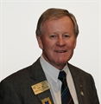

PDG Chris Sims
Contribution to torquay rotary club and district 9780

Slide 2
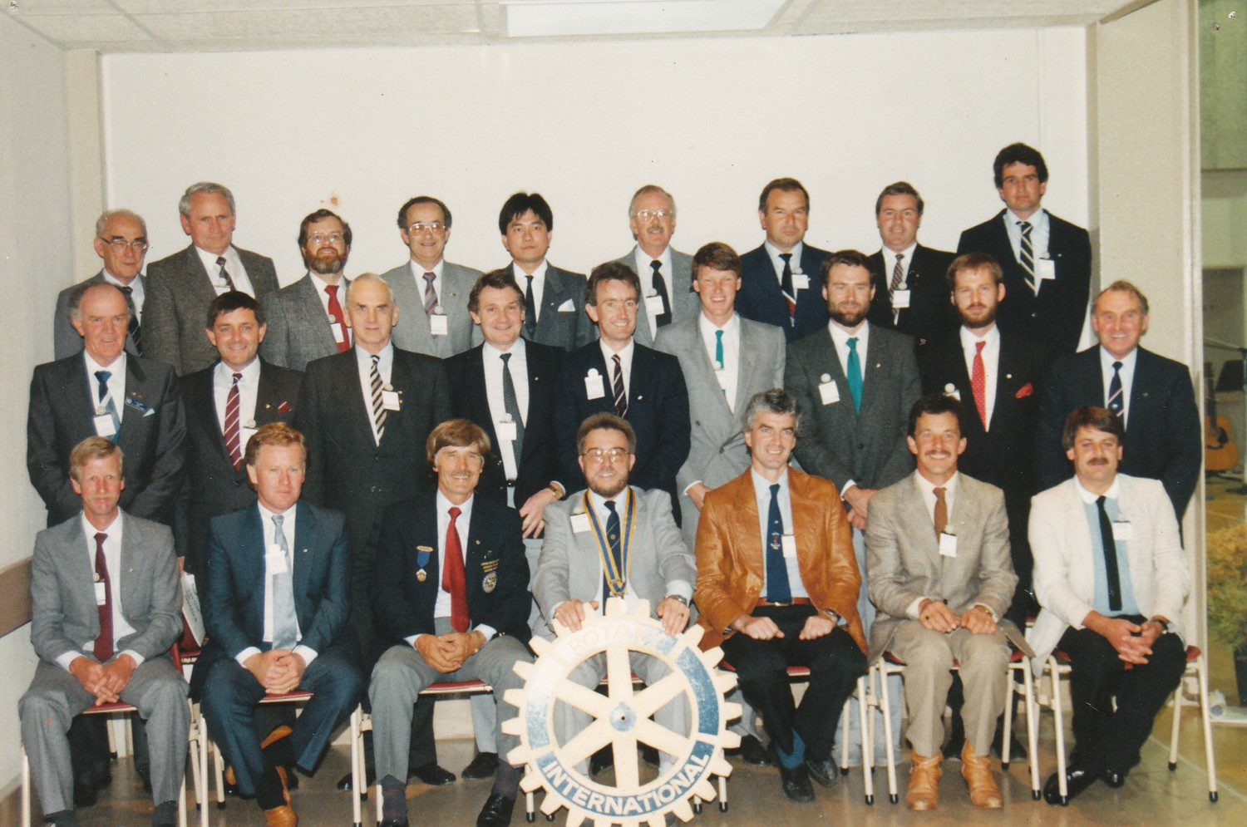
Charter member of Torquay Rotary Club 1988

Slide 3
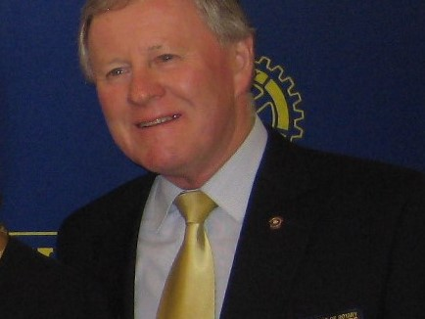

President of Torquay Rotary Club
1993/94
District Governor Dennis Wilson
Rotary Theme

Slide 4
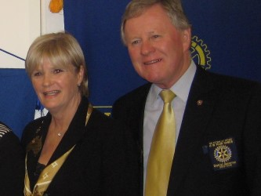

DISTRICT GOVERNOR 2009-10
The Future of Rotary is in your hands

Slide 5
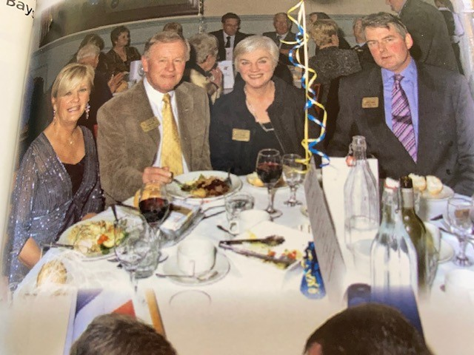
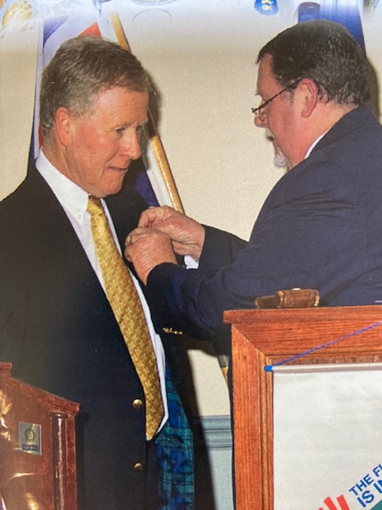
District Changeover 2009

Slide 6
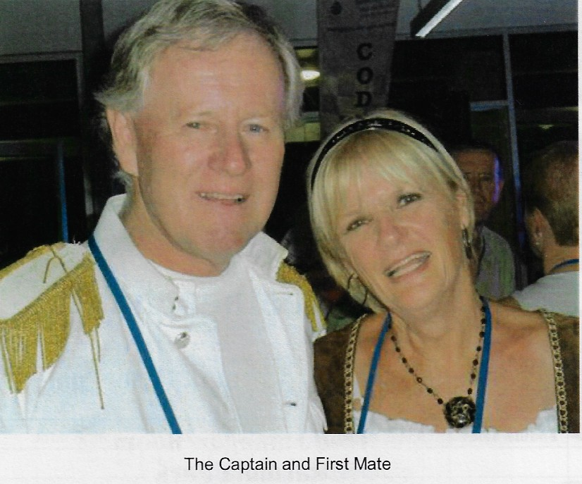
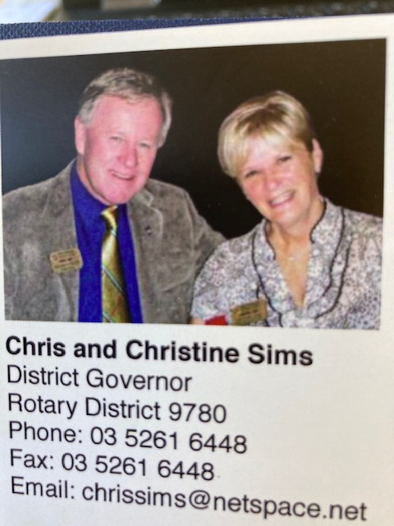
2010 District Governor year

Slide 7
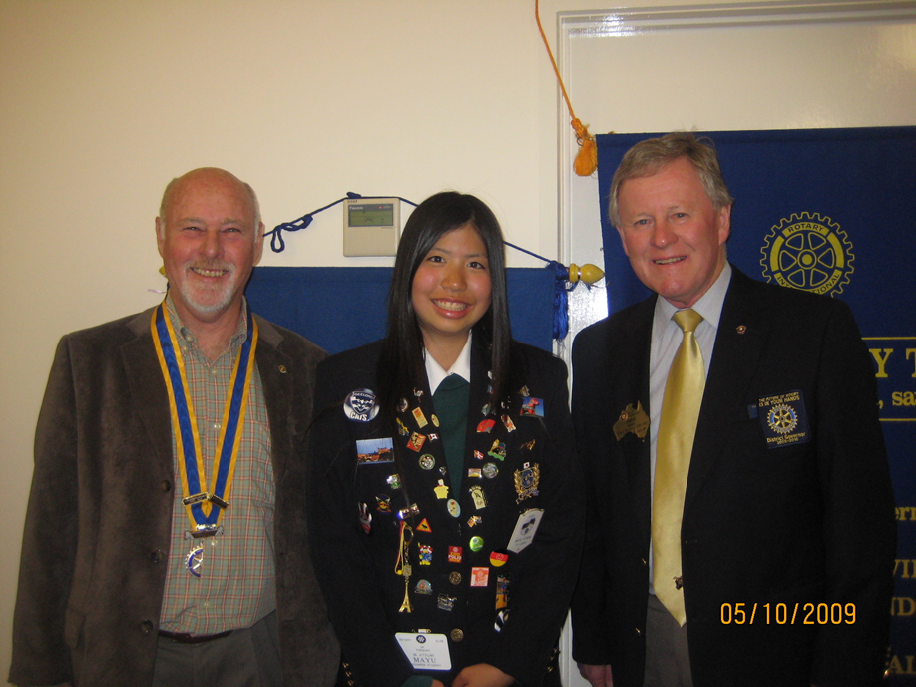
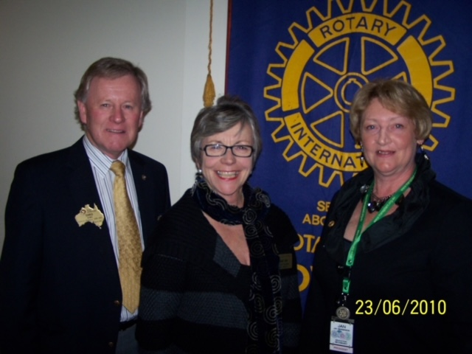
President Torquay Rotary Greg Birchall Exchange student Mayu
President Grovedale Rotary Jan Gillett
Assistant Governor Maggie Isom

Slide 8
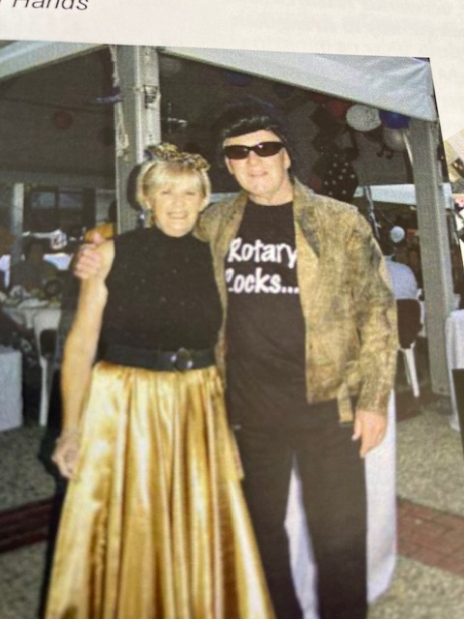
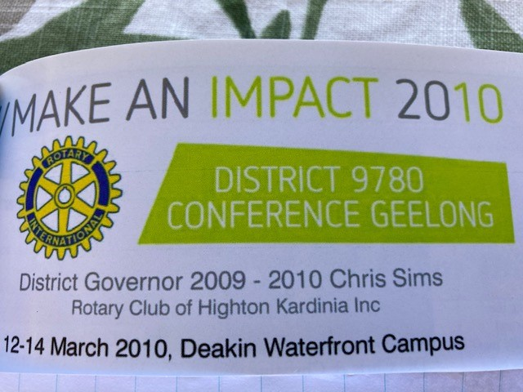
District Conference

Slide 9
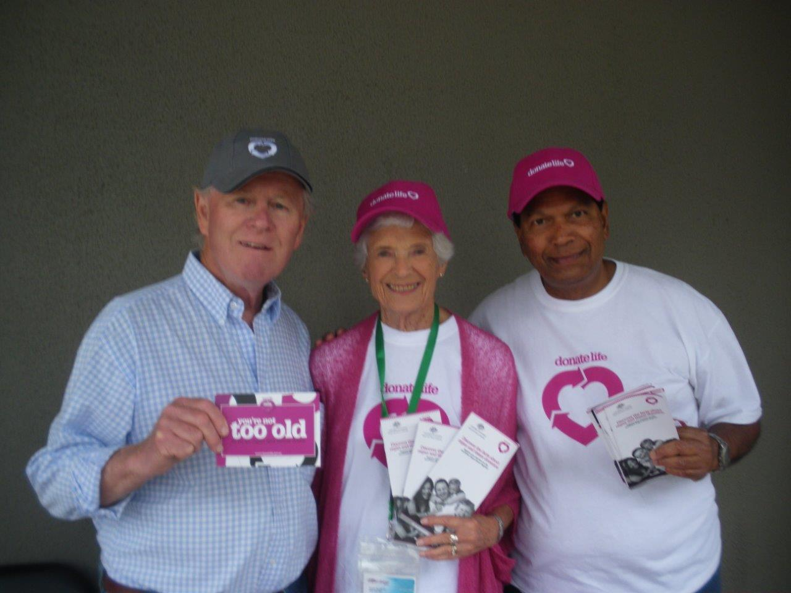

CLUB INVOLVEMENT

Slide 10

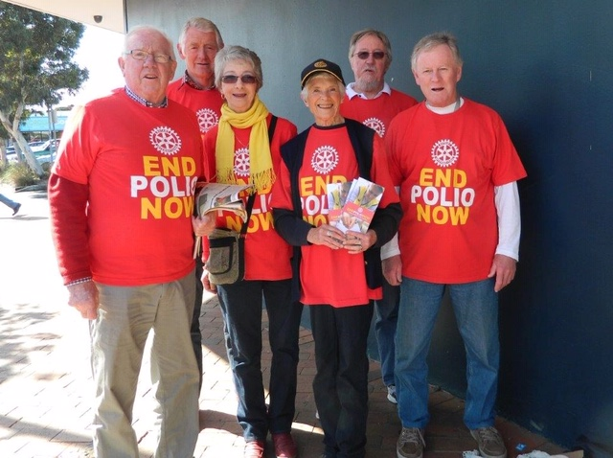
Support with Events /Activities

Slide 11
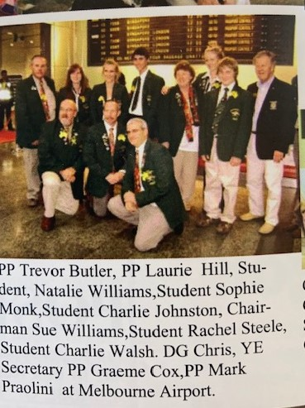
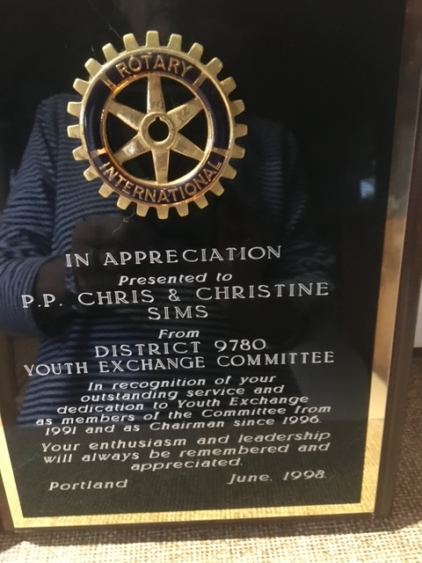
District 9780 Involvement
Youth Exchange 1991- 98
Chairman 1996-98

Slide 12



DISTRICT 9780 Involvement

Slide 13
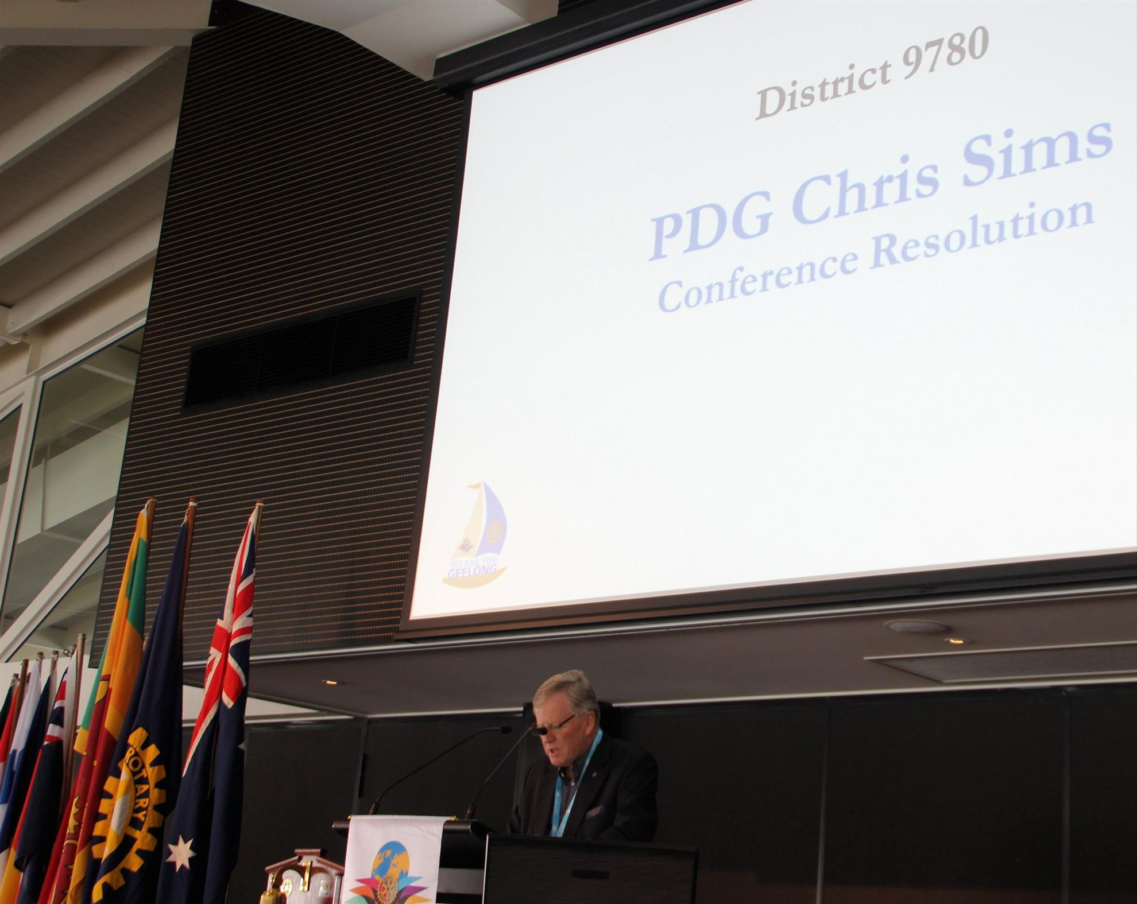
Always our representative with Conference resolutions

Slide 14
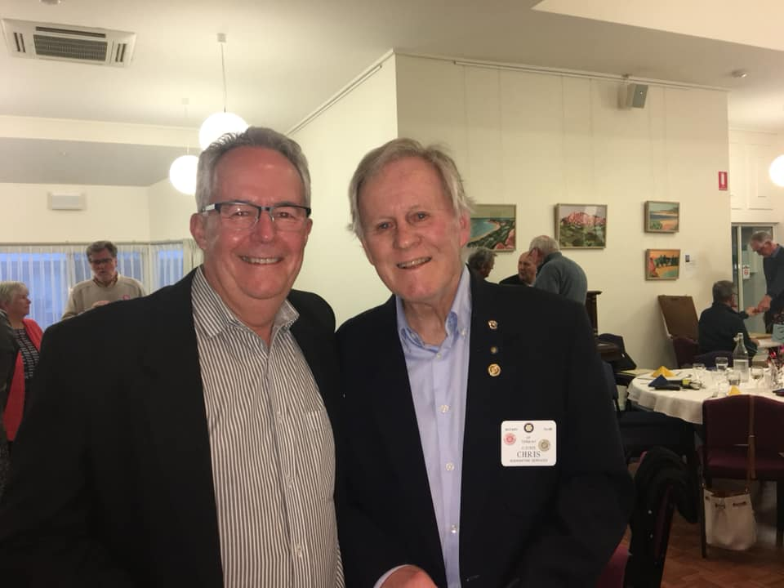
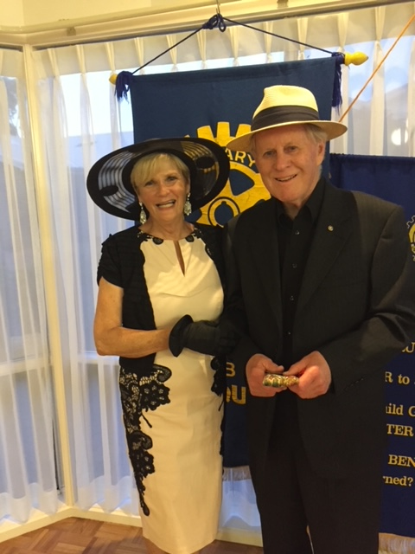
2020 -21 District Governor Phil Beasley

Slide 15

Thank you Chris Sims for all your significant and meritorious service to
Torquay Rotary Club &
District 9780 over 38 years

